Slide 1
Practice 2 - FIFO (FCFS)

Slide 2
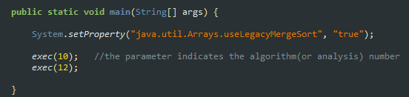
FIFO (FCFS)
You should Implement FIFO scheduler in CPUScheduler V1
Follow the following steps
Algorithm number should be 12; modify _Exec_set.java as follows

Slide 3
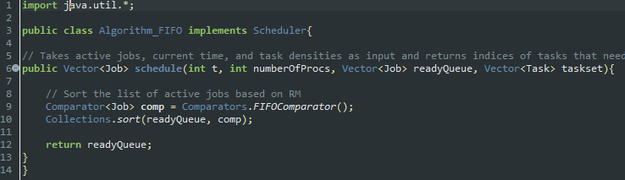

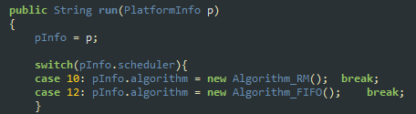
FIFO (FCFS)
Create Algorithm_FIFO.java, and it should contain codes as follows
Simulator.java should additionally contain case 12: as follows

Slide 4
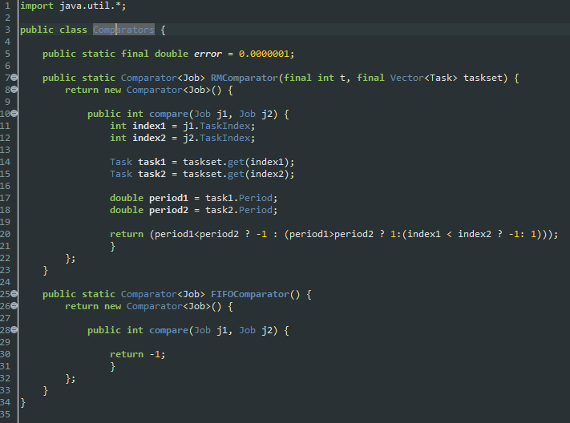
FIFO (FCFS)
Modify Comparators.java as follows

Slide 5
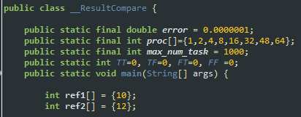
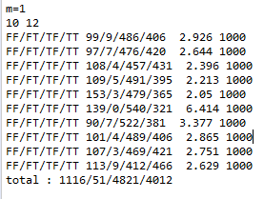

FIFO (FCFS)
_ResultCompare.java should be modified as follows; ref1[] = {10}, ref2[] = {12}
After correctly modifying Comparators.java, you see the following result by executing __ResultCompare.java
With GlobalData.java setting as
Note that output figures can be slightly different with the captured one

